Slide 1
Van Buren Community Schools
District Wellness Committee

Slide 2
Agenda
Farm to School
Team Nutrition Grants
Student Health Index-Elementary
School Wellness Webinar/Employee Wellness

Slide 3
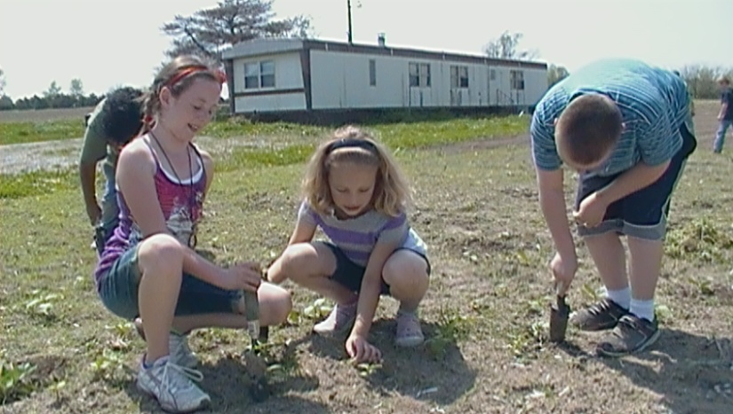
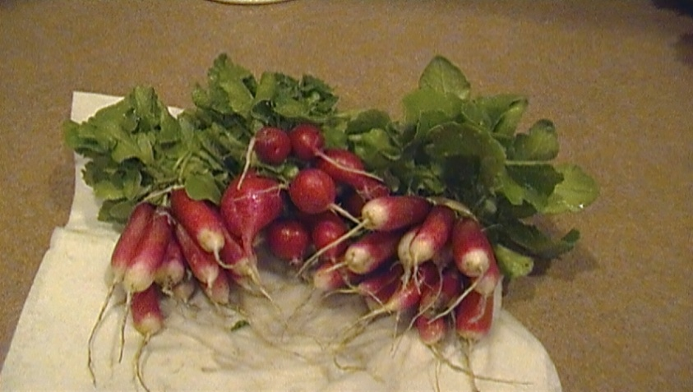
Farm to School
Mini-Conference-Monday, May 9th
  Procurement
  Food Service and Producers
  School Garden 101-Teachers
Greenhouse
School Garden/People’s Garden
Notes:
Apple trees-
Mini-Conference- Elisabet report on if present.
School Garden 101-2012
Judy-Report
Greenhouse-On hold
School Garden-Planting started April 4th-Serving radishes and lettuce this week. Classes planting fall crops this week. Kindergarten-class pumpkin growing contest. Thanks to Bob Waugh for tilling, planting corn, and cucumbers. Kim Blair donated seeds and plants.
PTO- $100 for equipment…bought fertilizer, will get more plants, hoe?, hose? Need rain barrel.
PASS OUT SIGN-UP SHEET

Slide 4
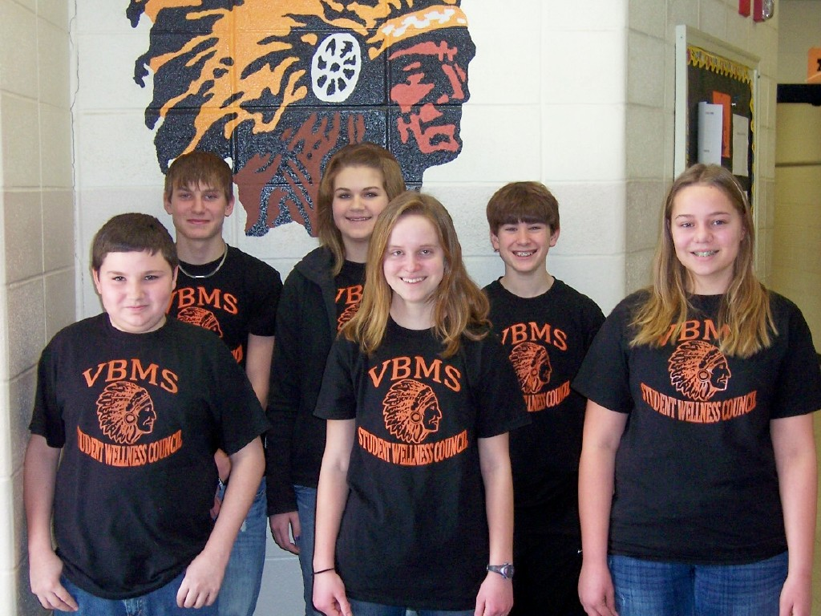
Team Nutrition Grants
Middle School Super-Power Summit
  Family Dinner Night
  Wellness Challenge
Student Wellness Council
  Front row: Amos Stovall,
  Sydney Atwood, Meghan
  Rickels
  Back row: Sheldon Dewitt,
  Sarah Frey, Brayden Starnes
Notes:
Family Dinner Night-bad weather…do over?
Served spaghetti, salad, homemade bread, and locally grown apples. Wii Just Dance was enjoyed by the students.
Lunch Survey- 17 completed (majority staff). 53% eat lunch every day. 82% thought the kitchen staff were average to friendly and helpful. 53% stated the quality of the main entrée varies daily, no one said it was consistently high quality. 53% said the salad bar was generally good and 18% said it was consistently high quality. Comments include: Would like to see more variety, like to try potato bar, taco salad, and soup. 65% stated the nutritional content of the food served was fairly nutritious, 39% felt it had poor nutritional content, only 6% thought it is highly nutritious. 71% thought there is not a lot of variety in the menu. 82% said the meals were not filling.
Wellness challenge-Weekly food and activity log. Incentives-water bottles, jump ropes, drawstring backpacks, walmart and subway gift cards, passes to swim at Fairfield Rec. and T-shirts. Weekly winners-1 from each grade and 1 staff member. Selected from different category each week (student not aware of weekly category) ex: who exercised the most minutes, ate the most servings of fruits and veggies, most water drank, etc. Healthy tips during morning announcements.

Slide 5
Team Nutrition Grants
Awarded-
  Go the Distance Day
    Elementary
    Middle School
  School Cafeteria Electronic Health Message Flat Screen
Applied-
  Farm to School
  School Youth Garden
Notes:
Elementary-$500-Farm Safety Day-Activity (minute-to-win-it) and taste-testing (kiwano, mango, UGLI fruit, purple cauliflower, kiwi, cherimoya, passion fruit, pineapple, taro root, cactus pear, and kumquats.
Gave “pocket pal” about why you should eat school breakfast and lunch, also healthy recipes.
Middle School-$500-Medieval Day-Taste-test-fruits and veggies from that time-carrots, turnips, cherries.
Flat Screen-$500 to purchase to display health messages, including menus. Will be in cafeteria/study hall.
Farm to School-$500-Garden activities during summer camp. Students help prepare produce to eat for lunch that day.
Composting activities/worm composter, Farmers’ Market at end of camp to use “money” to purchase produce.
School Youth Garden-$500-Same as Farm to School. Create cookbook with recipes from home using produce we are learning about. Local producers and gardeners will be asked to talk to students about their experiences and provide local produce for students to taste.

Slide 6
School Health Index
Elementary
  2006 vs. 2011
  School Health Index Team
    Principal
    Guidance Counselor
    Custodian
    2 Teachers (Kindergarten & 4th Grade)
    Food Service Manager
    School Nurse
Notes:
2006 vs. 2011
School Health Index-A self-assessment from CDC. Not required but provides valuable information to school staff. Recommended to complete every 3 years.

Slide 7
School Health Index

Slide 8
School Health Index
Strengths
  Physical Education & Physical Activity Programs
  Nutrition Services
Weaknesses
Safety
Asthma
Employee Wellness
Physical Activity
Parent & Community Involvement in Programs
Notes:
Compare BMI-report back in the Fall, correlate with increase scores in Physical activity and Nutrition module?
Safety-paras check playground every a.m., Improve review of playground safety with staff and students. Review procedures for injury reports with staff at August in-service. Encourage bus drivers to turn off buses to decrease exhaust fumes.
Asthma-Group of asthma students. Educate classmates-Sara and Nancy.
Staff Wellness-formal wellness program. Incentives?
150 minutes of physical activity per week-NFL Fuel up to Play 60 program, 5 minutes of activity during morning announcements.
Parent & Community Involvement in Programs-website link to nurse/counselor. Weekly newsletter/calendar from nurse/counselor-have parents sign-up at registration. Include events ex: Kaye’s visits, mouthrinse, menu, etc.
Utilize Healthy Newz 4U newsletter for students and one for parents.

Slide 9
Employee Wellness
School Wellness Webinar
Employee Wellness Program
Notes:
Melissa
Staff Wellness survey
Incentives?
Health Risk Appraisel?

Slide 10
End of Year Report
Health Screenings-
Vision Screenings
  146 students screened
  9 referred
  3 now wearing glasses
Dental Screenings
  98% of Kindergarteners
    11 required dental care, 2 required urgent care
  51% of 9th Graders
    4 required dental care, 0 urgent dental care
Notes:
School Nurse performed 19 out of 53 of the kindergarten screenings.

Slide 11
End of the Year Report
Catch-A-Smile Fluoride Mouthrinse
  1st grade through 5th grade
Give Kids A Smile Day
  Dr. Roth, Fairfield
  6 Students
Sealants
  LCHD grant
  2nd Grade
Vaccinations
  Influenza
Notes:
Catch-A-Smile-28 weeks this year, for maximum benefit schools are asked to do at least 25 weeks. 86% of 1st graders, 86% of 2nd graders, 75% of 3rd graders, 80% of 4th graders, 74% of 5th graders.
Next year…no funding?
GKAS-3 Kindergarten, 1- 2nd grade, 2- 3rd grade. 1 had dental work performed (cavities filled).
Sealants-30 dental screenings, 81 sealants placed, 9 had decay.
Vaccinations-Staff Influenza-58, Hep B series 2 (just received vaccine, not started yet)

Slide 12
End of Year Report
First Aid/CPR
  115 trained
Articles in Newspaper
  Middle School Health Fair
  Student Wellness Council
Classroom Education
  Hygiene-3rd and 5th
  Human Growth & Development-4th and 5th
  Organ Donation
Notes:
First Aid and/or CPR-65 Students, 24 School Staff, 12 Milton Fire, and 14 4-H Leaders/Senior council members
Classroom Education-Thanks to Dr. Blair for doing “the talk”.
Elementary Salad Bar survey, Group of students at High School-talk about meals.

Slide 13
Upcoming Events
Elementary Fun Day-Friday, May 20th
Middle School Medieval Day-Friday, May 20th
Summer Camp-Monday, June 6th–Friday, June 24th
  Van Buren Elementary
  8:30 a.m. to 12:30 p.m. daily
Kid’s Health Fair-Thursday, August 4th
  Roberts Memorial Building
  3:30 p.m. to 5:30 p.m.

